Slide 1
Image Processing INT3404 20 Week 7: Feature extraction Edge, Line, Texture
Lecturer: Nguyen Thi Ngoc Diep, Ph.D.
Email: ngocdiep@vnu.edu.vn
Notes:
7 13h00’  13h50’ 10’
8 14h00’  14h50’ 10’
9 15h00’  15h50’

Slide 2
Schedule
Tuần | Nội dung | Yêu cầu đối với sinh viên (ngoài việc đọc tài liệu tham khảo)
1 | Giới thiệu môn học | Cài đặt môi trường: Python 3, OpenCV 3, Numpy, Jupyter Notebook
2 | Ảnh số (Digital image) – Phép toán điểm (Point operations) Làm quen với OpenCV + Python Điều chỉnh độ tương phản (Contrast adjust)– Ghép ảnh (Combining images)
3 | Histogram - Histogram equalization | Làm bài tập 1: điều chỉnh gamma tìm contrast hợp lý
4 | Phép lọc trong không gian điểm ảnh (linear processing filtering) | Thực hành ở nhà
5 | Phép lọc trong không gian điểm ảnh (linear processing filtering) (cont.) Thực hành: Cách tìm filters | Thực hành ở nhà
6 | Thực hành: Ứng dụng của histogram; Tìm ảnh mẫu (Template matching) | Bài tập mid-term
7 | Trích rút đặc trưng của ảnh Cạnh (Edge) và đường (Line) và texture | Thực hành ở nhà
8 | Các phép biến đổi hình thái (Morphological operations) | Làm bài tập 2: tìm barcode
9 | Chuyển đổi không gian – Miền tần số – Phép lọc trên miền tần số Thông báo liên quan đồ án môn học | Đăng ký thực hiện đồ án môn học
10 | Xử lý ảnh màu (Color digital image) | Làm bài tập 3: Chuyển đổi mô hình màu và thực hiện phân vùng
11 | Các phép biến đổi hình học (Geometric transformations) | Thực hành ở nhà
12 | Nhiễu – Mô hình nhiễu – Khôi phục ảnh (Noise and restoration) | Thực hành ở nhà
13 | Nén ảnh (Compression) | Thực hành ở nhà
14 | Hướng dẫn thực hiện đồ án môn học | Trình bày đồ án môn học
15 | Hướng dẫn thực hiện đồ án môn học Tổng kết cuối kỳ | Trình bày đồ án môn học

Slide 3
Recall

Slide 4
Week 7: Feature extraction
Edge, Line, Texture

Slide 5
Edge detection

Slide 6
What is an edge?
- An edge = a significant local change in the image intensity
Image credit: Gonzalez et.al., Fig. 10.2

Slide 7
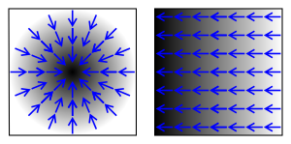
Image gradient
Two types of gradients, with blue arrows to indicate the direction of the gradient. Dark areas indicate higher values

Slide 8
Gradient
Gradient of a function indicates how strong the function increases.
For 1-dimension function:
Grad(2)=4 indicates the the increasing direction of the function is to the right.
Grad(-1)=-2 indicates the increasing direction of the function is to the left.

Slide 9
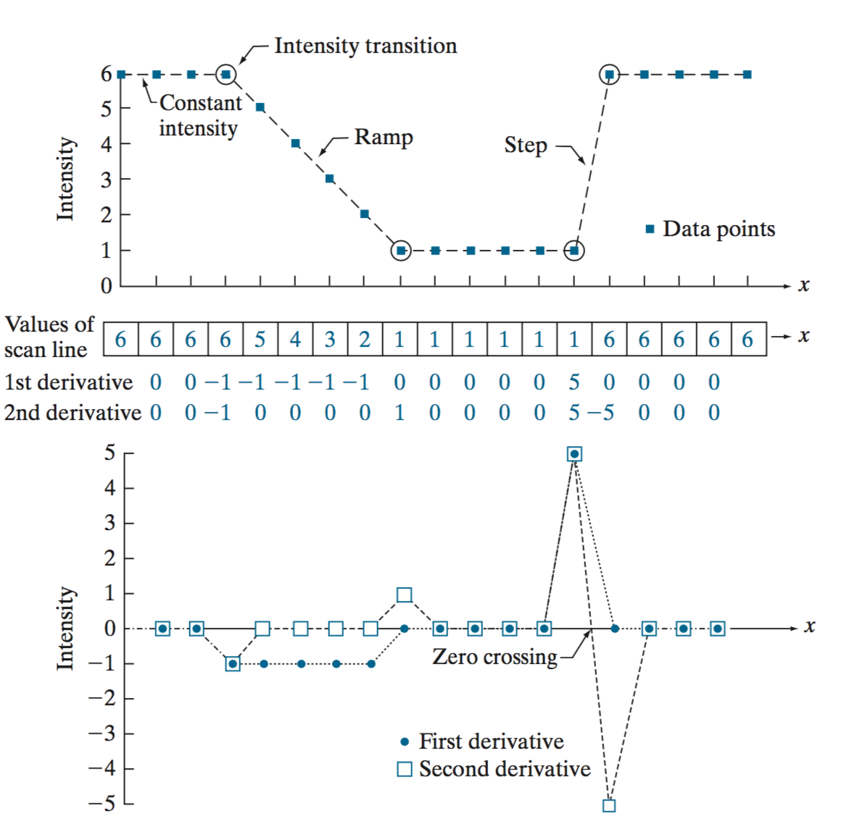
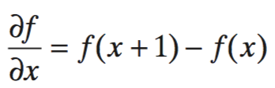
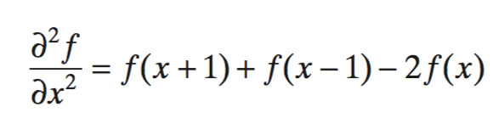
First-order and second-order derivatives
Image credit: Gonzalez, Fig. 3.44

Slide 10
Edge detection using derivatives
Detecting the local maxima or minima of the first derivative
(2) Detecting the zero-crossings of the second derivative
Image credit: MIPAV

Slide 11
Gradient of 2D discrete function
Gradient of a 2-dimension function is calculated as follows:
The gradient is approximated as follows (first-order derivative) :

Slide 12
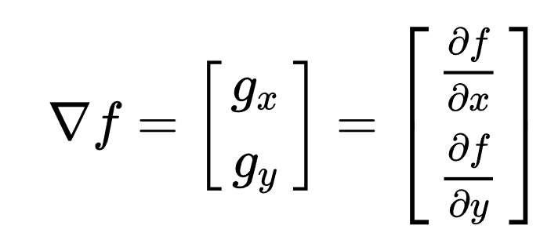
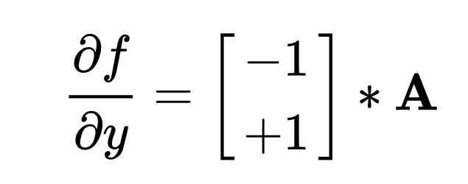
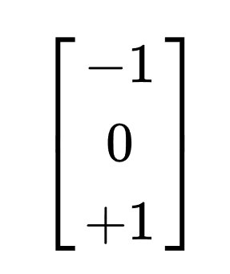

Gradient of 2D image
convolution
Approximated by finite differences
Avoid shifting of image

Slide 13
Gradient
The magnitude of gradient indicates the strong of edges:
Gradient computation procedure:
Calculate column gradient
Calculate row gradient
Calculate final gradient by the above function

Slide 14
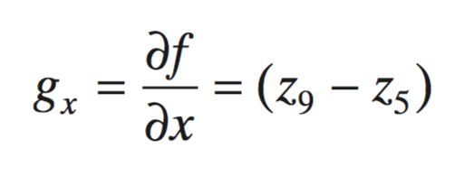
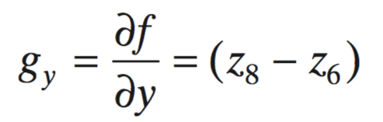
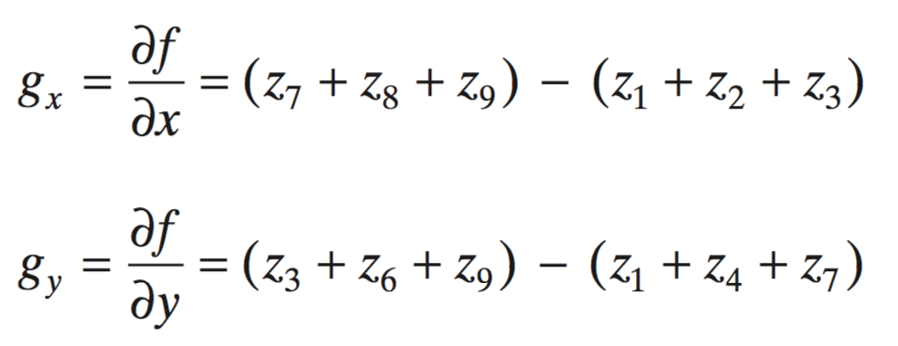
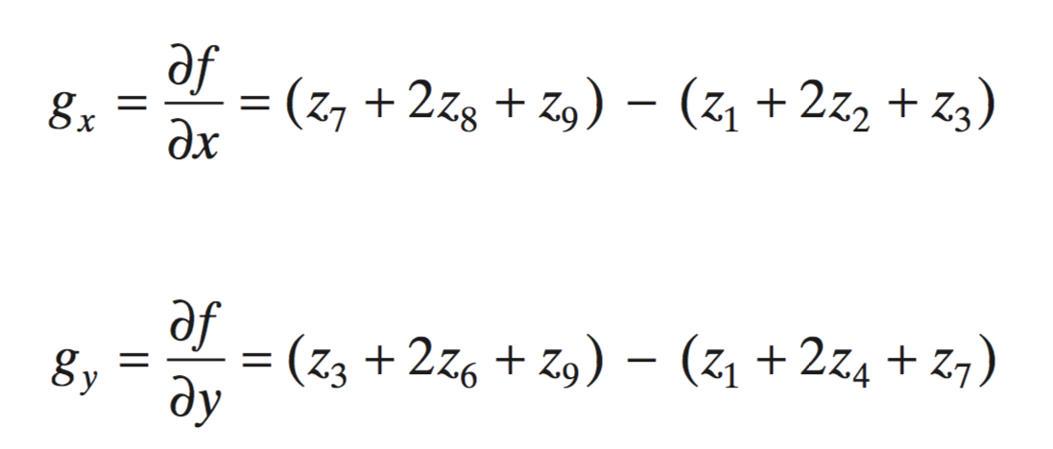
Various kernels used to compute the gradient
A 3x3 region of an image

Slide 15
Pixel Difference masks
Column mask
Row mask

Slide 16
Pixel difference example
Final edges
Original Image
Column
edges
Row
edges

Slide 17
Robert mask
Roberts masks calculate gradient from two diagonals
Column
Row

Slide 18
Robert mask example
Column
edges
Original Image
Final edges
Row
edges

Slide 19
Prewitt mask
Column
Row

Slide 20
Prewitt mask
Row
edges
Original Image
Final edges
Column
edges

Slide 21










Sobel mask
Column
Row

Slide 22
Sobel filter example
Original Image
Column
Combination
Row

Slide 23
Laplace gradient
Laplace edge in a continuous domain
In a discrete domain, Laplace edge is approximated by

Slide 24
Laplace mask

Slide 25
Laplace filter example
Original image I
|I*H|

Slide 26
Highboost filtering with Laplace
Overall
Using Laplace mask

Slide 27
Highboost filter example
Original Image
c=0.5
c=1

Slide 28
Gradient comparison
Pixel difference
Robert
Prewitt
Sobel
Laplace

Slide 29
More advanced edge detection

Slide 30
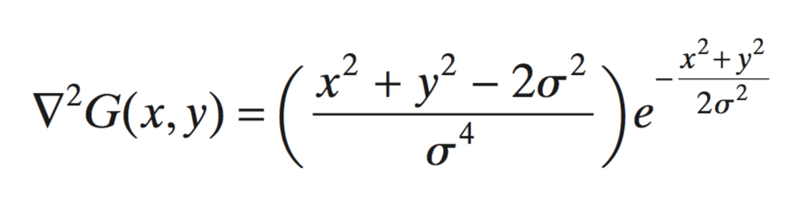
Laplacian of a Gaussian (LoG) (Marr-Hildreth algorithm)
An edge detection should:
Be a differential operator capable of computing a digital approximation of the first or second derivative at every point in the image
Be capable of being “tuned” to act at any desired scale, so that large operators can be used to detect blurry edges and small operators to detect sharply focused fine detail

Slide 31
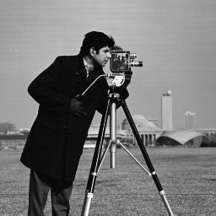
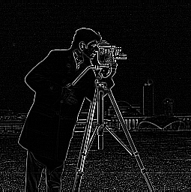
LoG gradient example
Original image
LoG filter

Slide 32
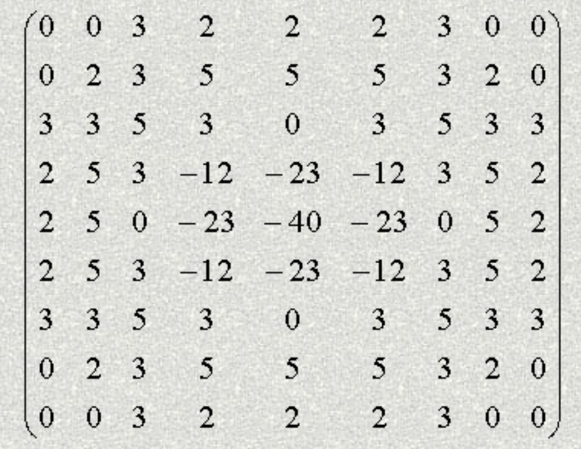
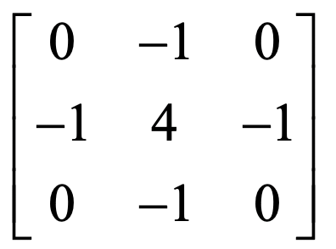

LoG edge detection

Slide 33

LoG edge detection example
Original image
LoG filtered
LoG edge

Slide 34
Canny edge detection
Smooth the input image with a Gaussian filter
Compute the gradient magnitude and angle images
Apply nonmaxima suppression to the gradient magnitude image
Use double thresholding and connectivity analysis to detect and link edges

Slide 35
Canny edge detection
1. Smooth with 5x5 Gaussian kernel
2. Gradient with Sobel kernels
3. Non-maximum suppression
4. Thresholding
https://towardsdatascience.com/canny-edge-detection-step-by-step-in-python-computer-vision-b49c3a2d8123

Slide 36

Canny edge detection example
Original image
Canny

Slide 37

Line detection
Hough transform

Slide 38
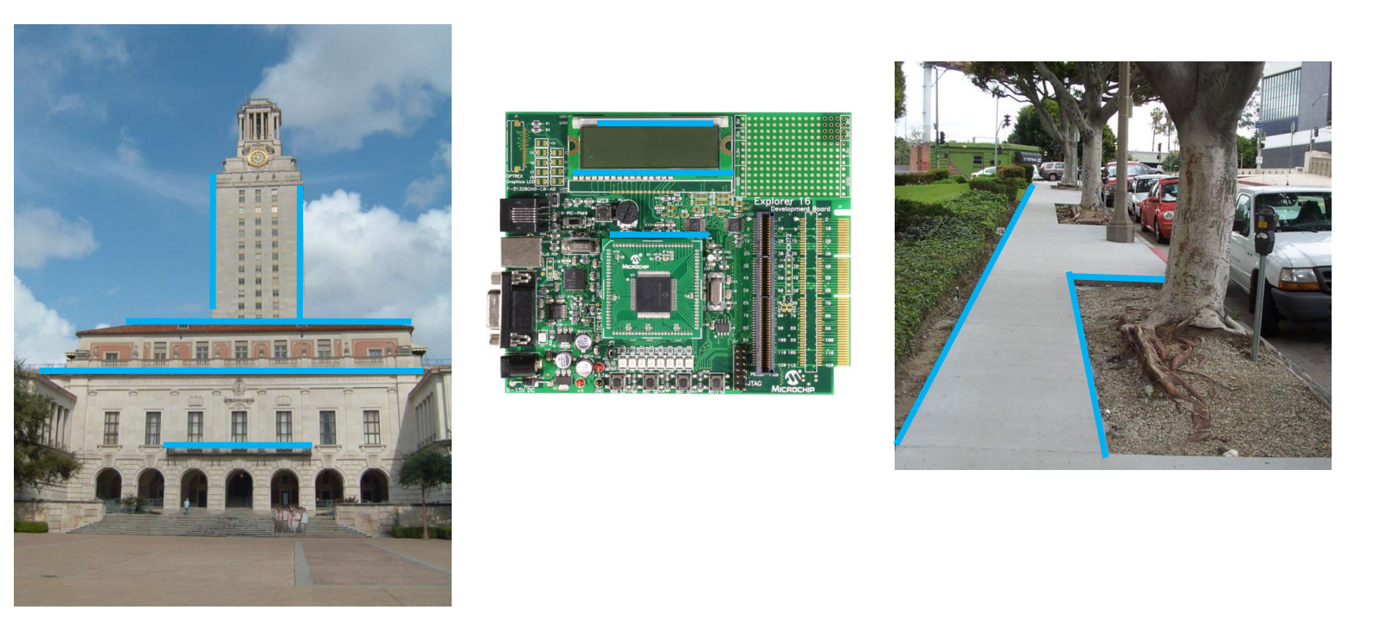









Example: Line fitting
Many objects characterized by presence of straight lines

Slide 39
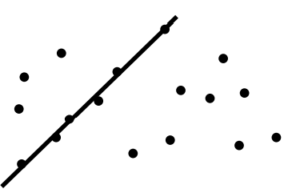
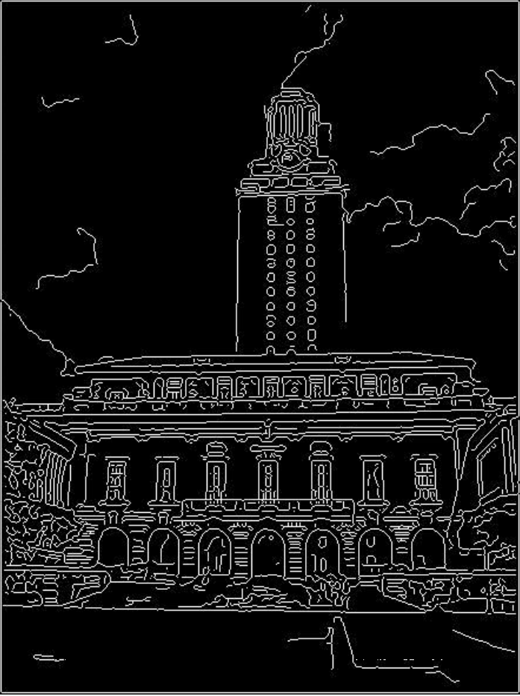









Difficulty of line fitting
Extra edge points (clutter), multiple models
Which points go with which line, if any?
Only some parts of each line detected, and some parts are missing:
How to find a line that bridges missing evidence?
Noise in measured edge points, orientations:
How to detect true underlying parameters

Slide 40
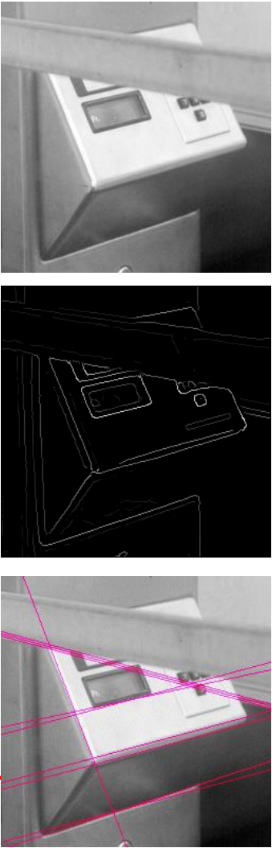
Fitting lines with Hough transform
Given points that belong to a line, what is the line?
How many lines are there?
Which points belong to which lines?
Hough transform is a voting technique that can be used to answer all of these questions
Main idea:
Record vote for each possible line on which each edge point lies
Look for lines that get many votes

Slide 41
Voting
It is not feasible to check all combinations of features by fitting a model to each possible subset
Voting is a general technique where we let the features vote for all models that are compatible with it
Cycle through features, cast votes for model parameters
Look for model parameters that receive a lot of votes
Noise & clutter features with cast votes too, but typically their votes should be inconsistent with the majority of “good” features

Slide 42
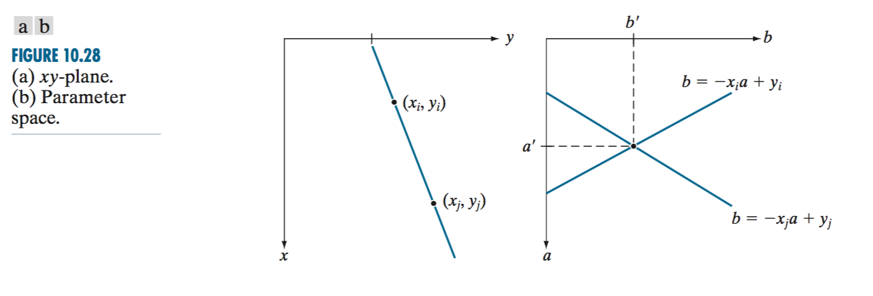





Line planes
ab-plane or parameter space
y = a’x + b’
What if the line approaches the vertical or horizontal direction?
(i.e., infinity slope)

Slide 43
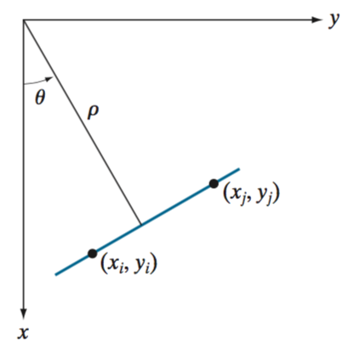



















Polar representation for lines
rho: perpendicular distance from line to origin
theta: angle the perpendicular makes with the x-axis
Normal presentation of a line:
→ Point in image space is now sinusoid segment in Hough space

Slide 44
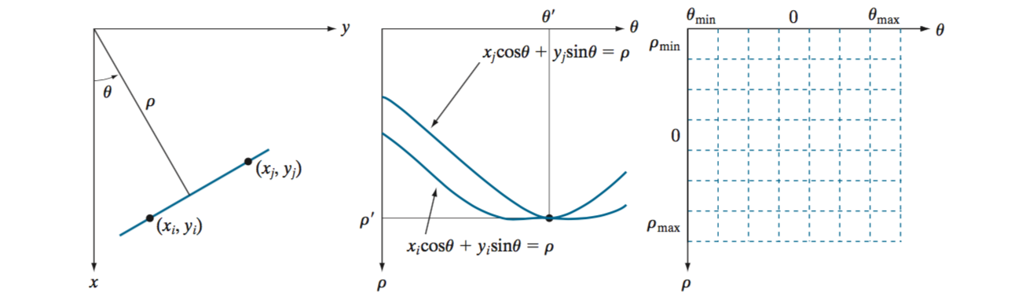
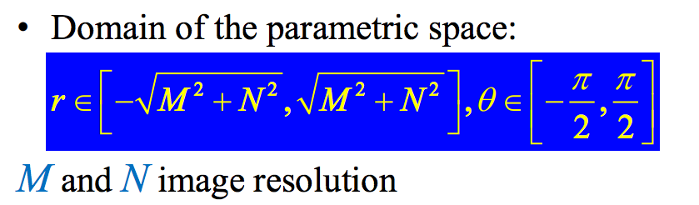
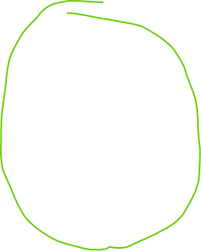


Finding lines in an image: Hough algorithm
1. Using the polar parameterization
2. Create a Hough Accumulator Array (keeps the votes)
Notes:
Horizontal theta=0
Vertical theta = +90 or -90

Slide 45
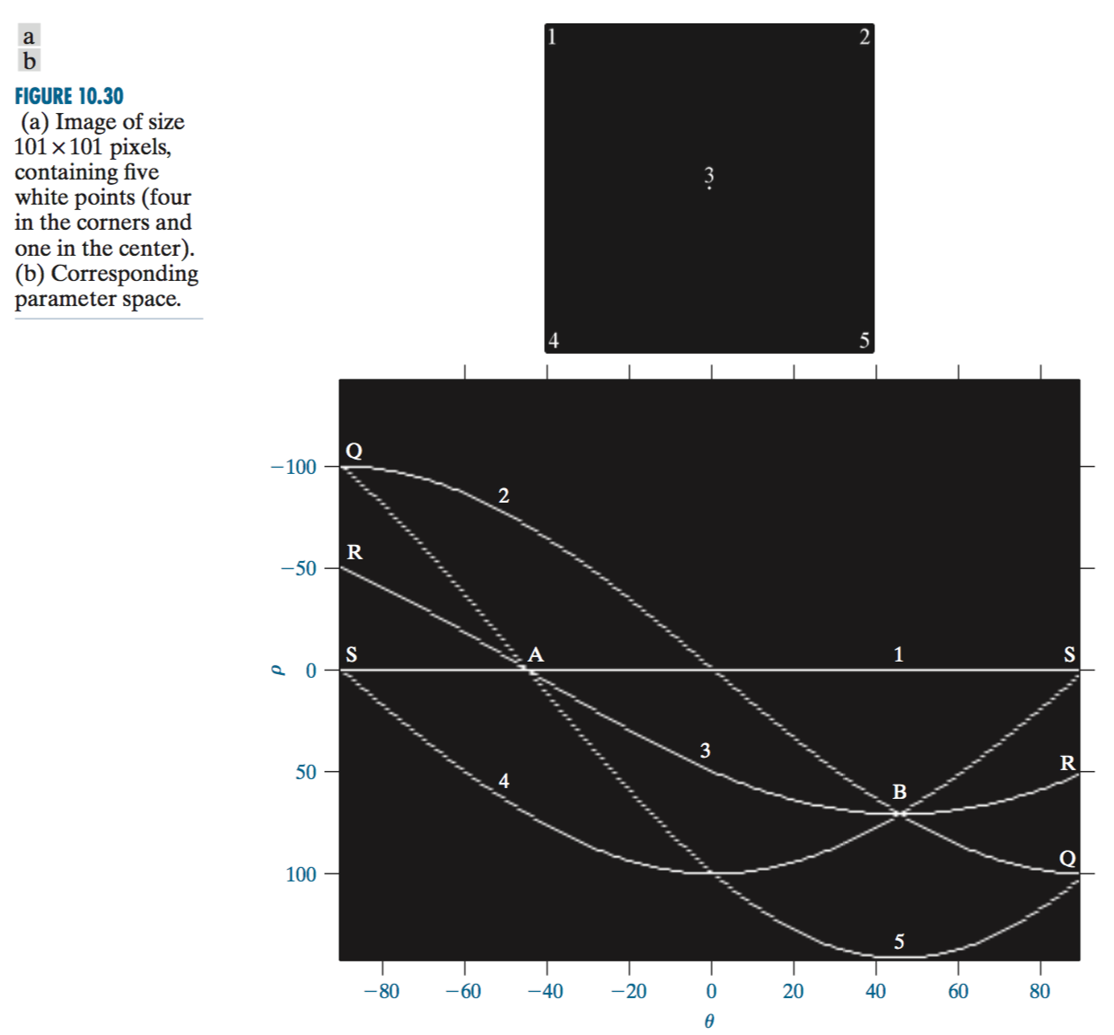





Example of Hough transform

Slide 46
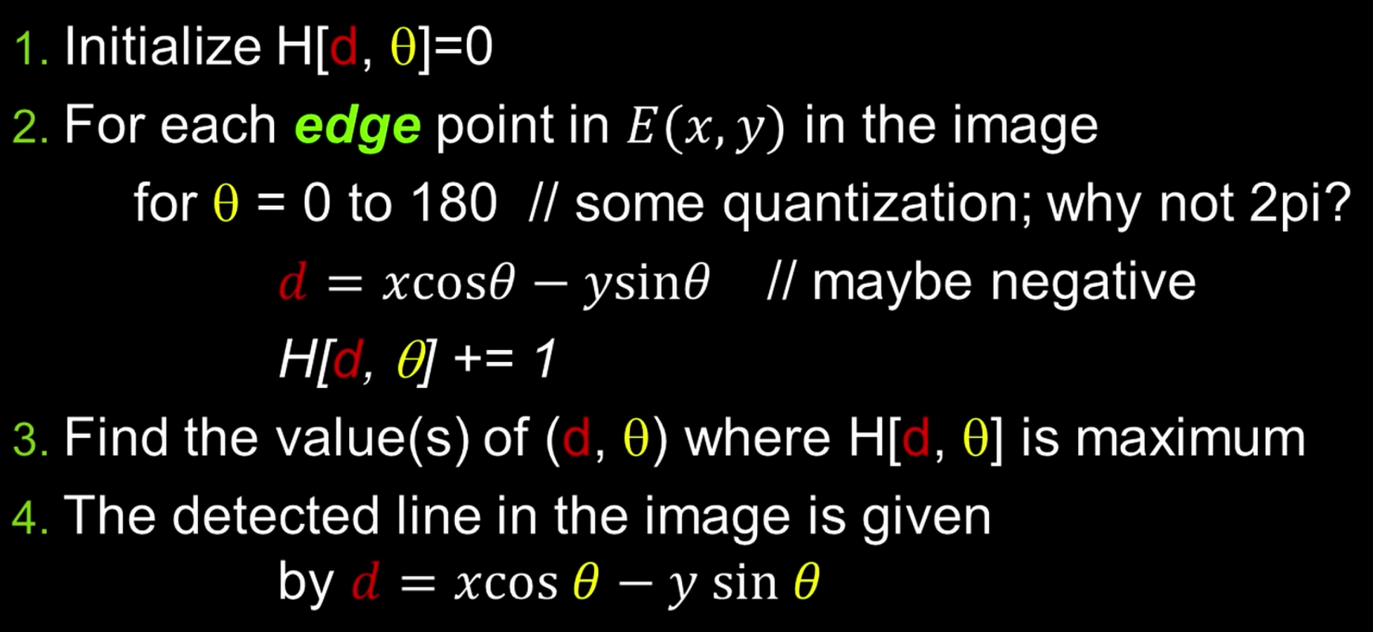











Basic Hough transform algorithm

Slide 47
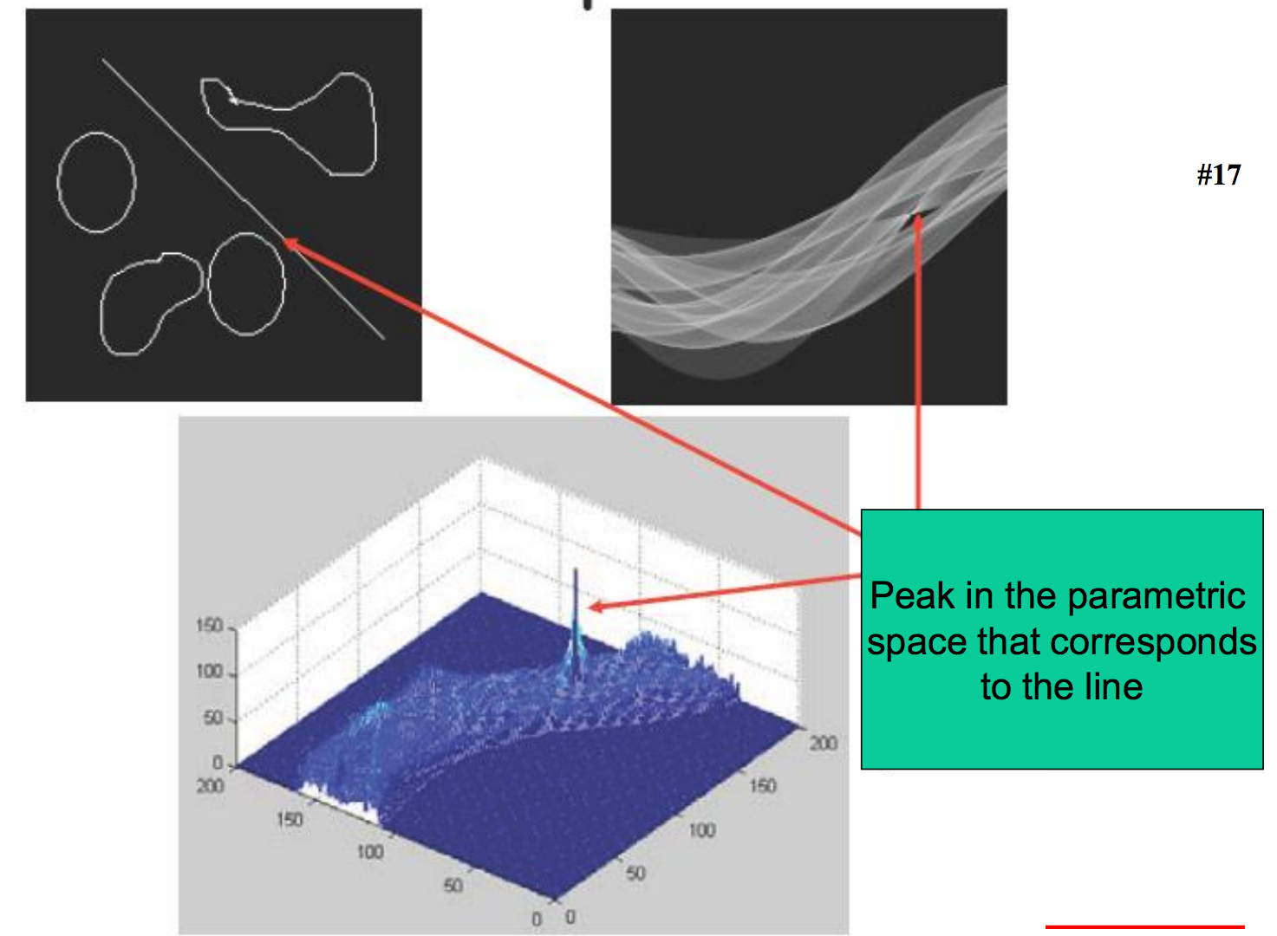

Line detection example

Slide 48
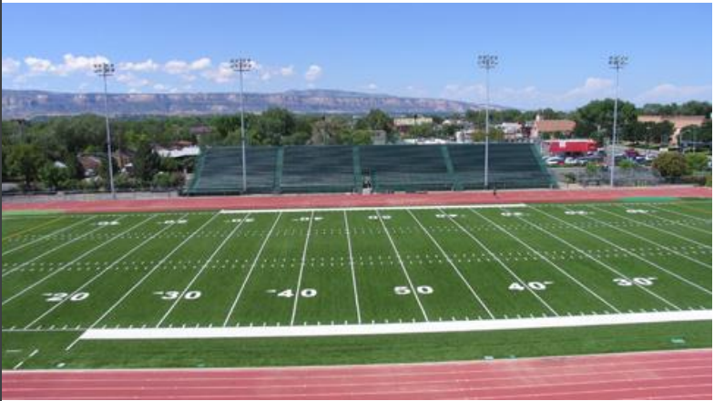
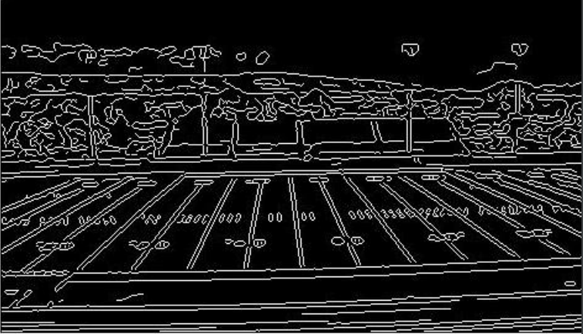
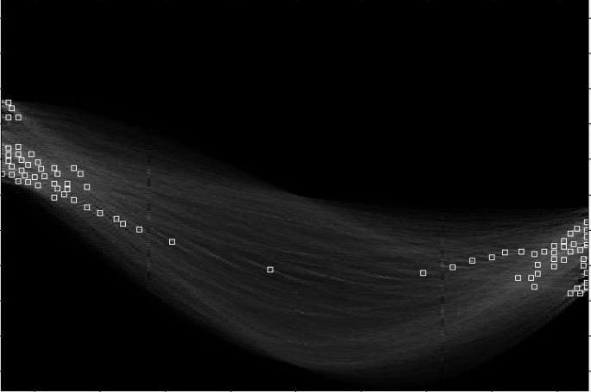
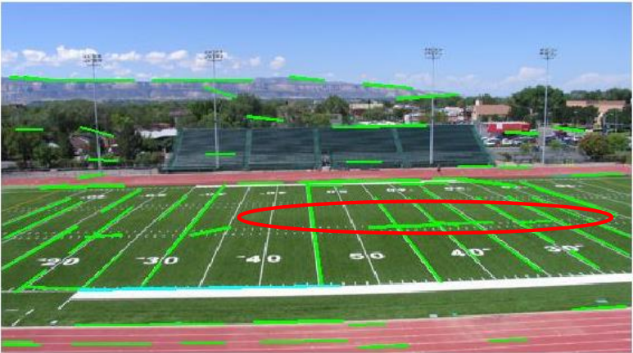





Line detection example
Canny edges
original
Vote space and top peaks
Longest segments found

Slide 49
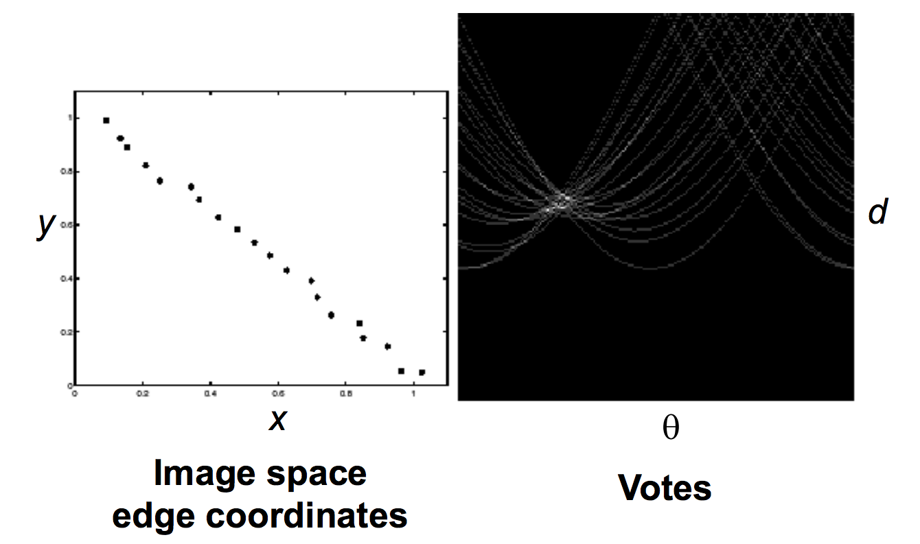






Impact of noise on Hough
What difficulty does this present for an implementation?

Slide 50
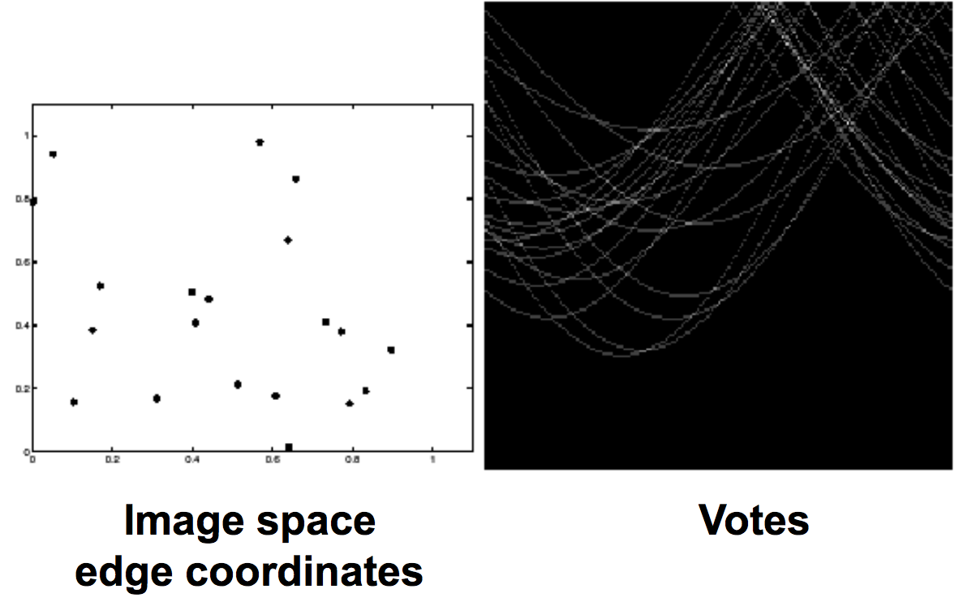

Impact of noise on Hough
Everything appears to be “noise”, or random edge points, but we still see some peaks in the vote space

Slide 51
Texture analysis

Slide 52
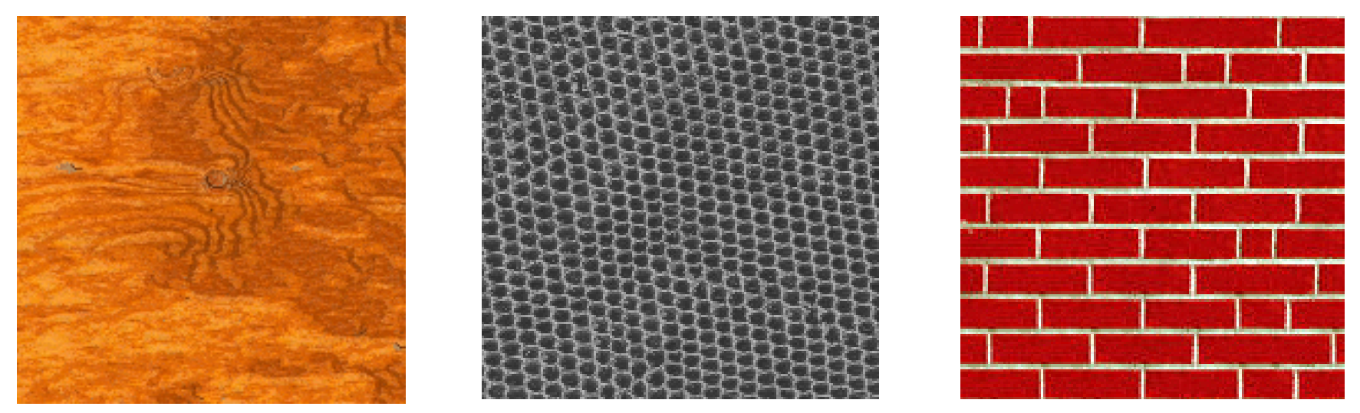
What is texture?
An image obeying some statistical properties
Similar structures repeated over and over again
Often has some degree of randomness

Slide 53
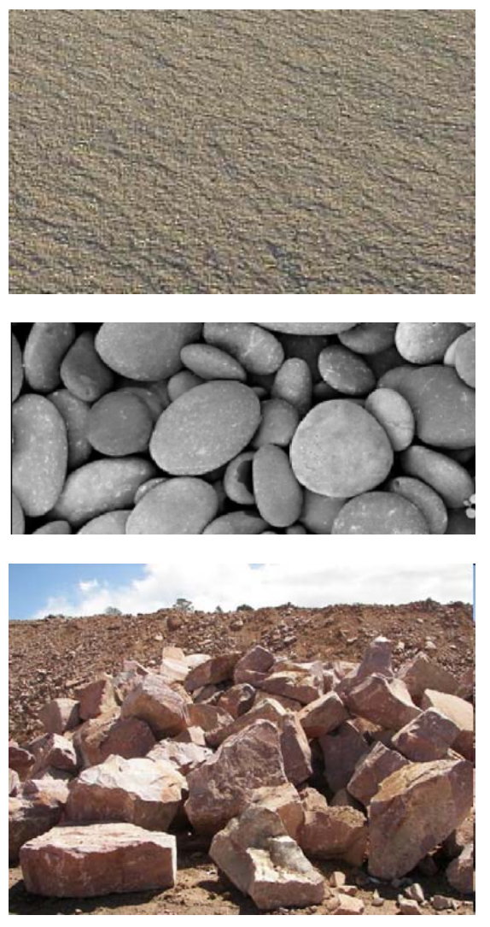
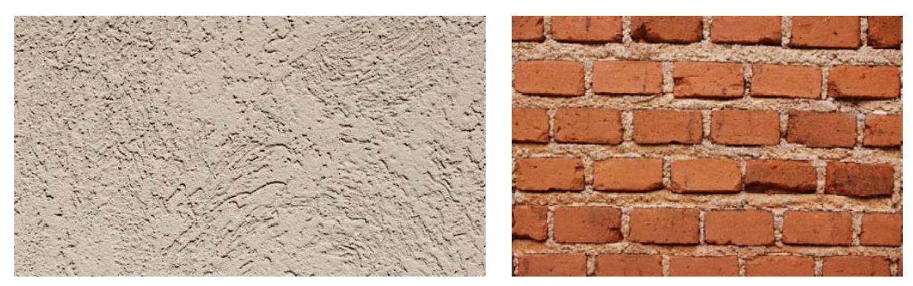
Aspects of texture
Size/granularity (sand versus pebbles versus boulders)
Directionality/Orientation
Random or regular (stucco versus bricks)

Slide 54
Statistical approach to texture
Characterize texture using statistical measures computed from grayscale intensities (or colors) alone
Less intuitive, but applicable to all images and computationally efficient
Can be used for both classification of a given input texture and segmentation of an image into different regions

Slide 55
Some (simple) statistical texture measures
Edge density and direction
Use an edge detector as the first step in texture analysis
The number of edge pixels in a fixed-size region tells us how busy that region is
The directions of the edges also help characterize the texture

Slide 56
Two edge-based texture measures
1. edgeness per unit area
2. edge magnitude and direction histograms
Fedgeness = |{ p | gradient_magnitude(p) ≥ threshold}| / N
where N is the size of the unit area
Fmagdir = ( Hmagnitude, Hdirection )
where these are the normalized histograms of gradient
magnitudes and gradient directions, respectively.

Slide 57
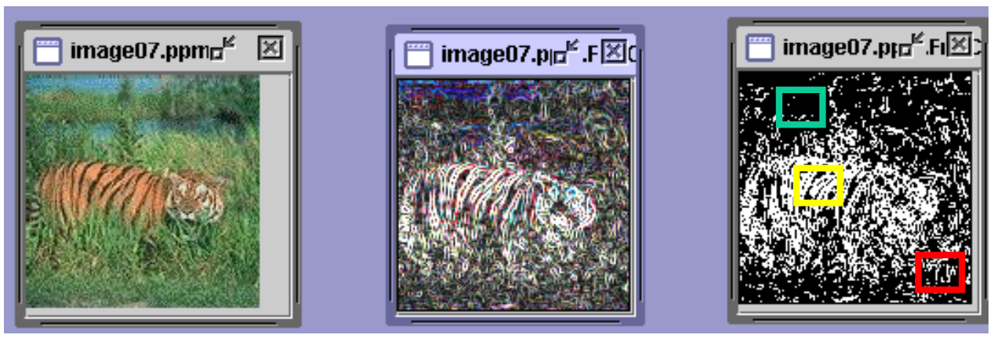
Example
Original Image Frei-Chen Thresholded
Edge Image Edge Image
Different F_{edgeness} for different regions

Slide 58
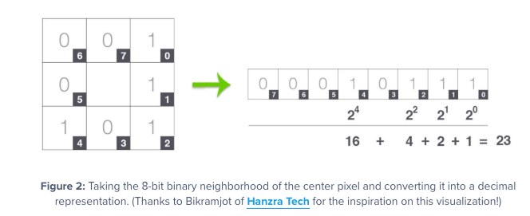
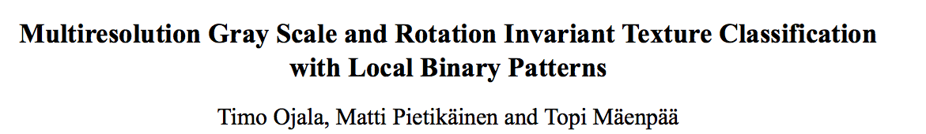
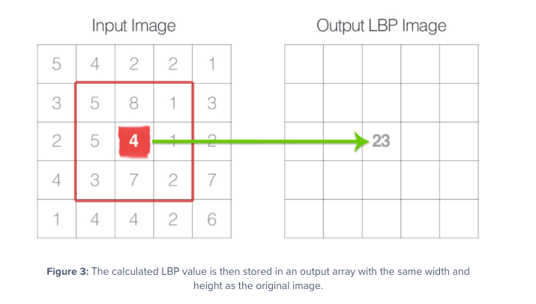
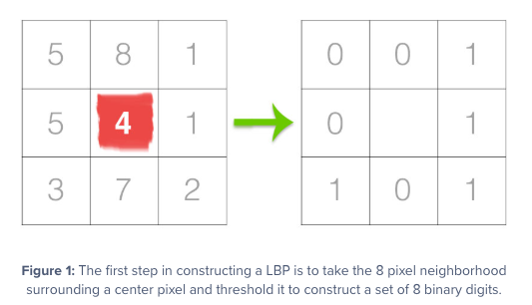
Local binary pattern measure
Image credit: https://www.pyimagesearch.com/2015/12/07/local-binary-patterns-with-python-opencv/
Notes:
PAMI paper 2
http://www.outex.oulu.fi/publications/pami_02_opm.pdf
For each pixel p, create an 8-bit number b1 b2 b3 b4 b5 b6 b7 b8,
where bi = 0 if neighbor i has value less than or equal to p’s
value and 1 otherwise.
Represent the texture in the image (or a region) by the
histogram of these numbers.

Slide 59
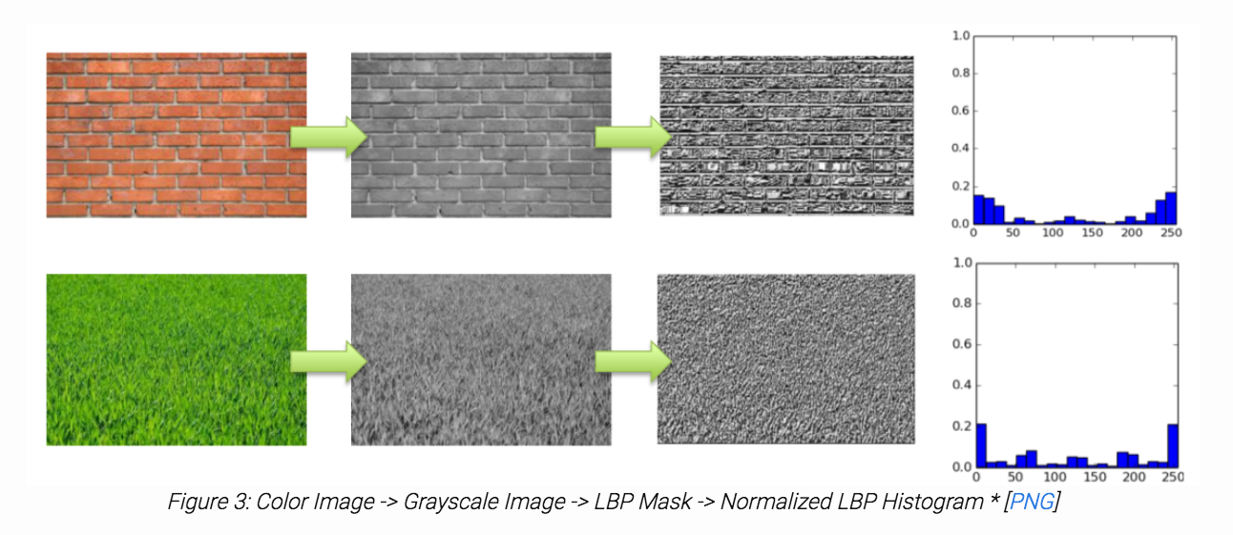
LBP example
Color Image -> Grayscale Image -> LBP Mask -> Normalized LBP Histogram
Image credit: http://hanzratech.in/2015/05/30/local-binary-patterns.html

Slide 60
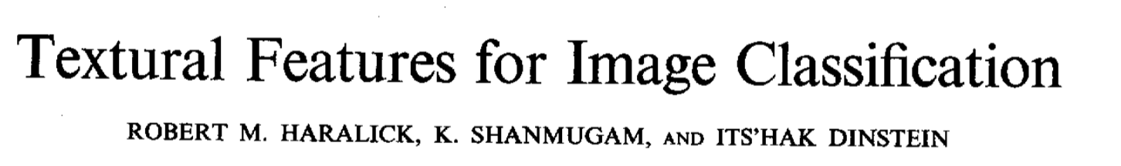
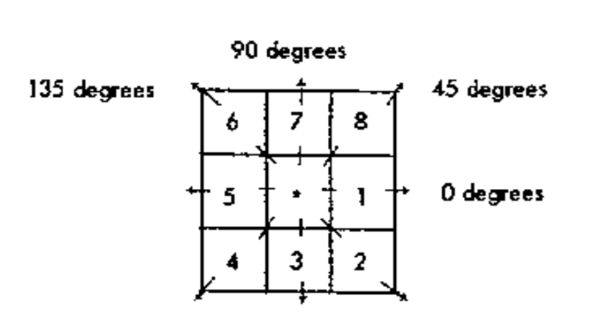
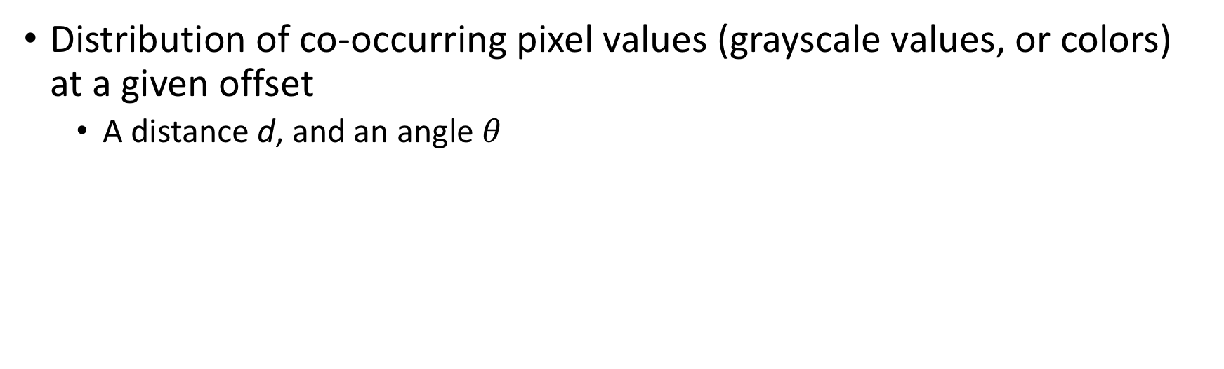
Gray Level Co-occurence Matrix (GLCM)
Distribution of co-occurring pixel values (grayscale values, or colors) at a given offset
A distance d, and an angle $θ$
Haralick features -→ contrast, correlation texture features

Slide 61
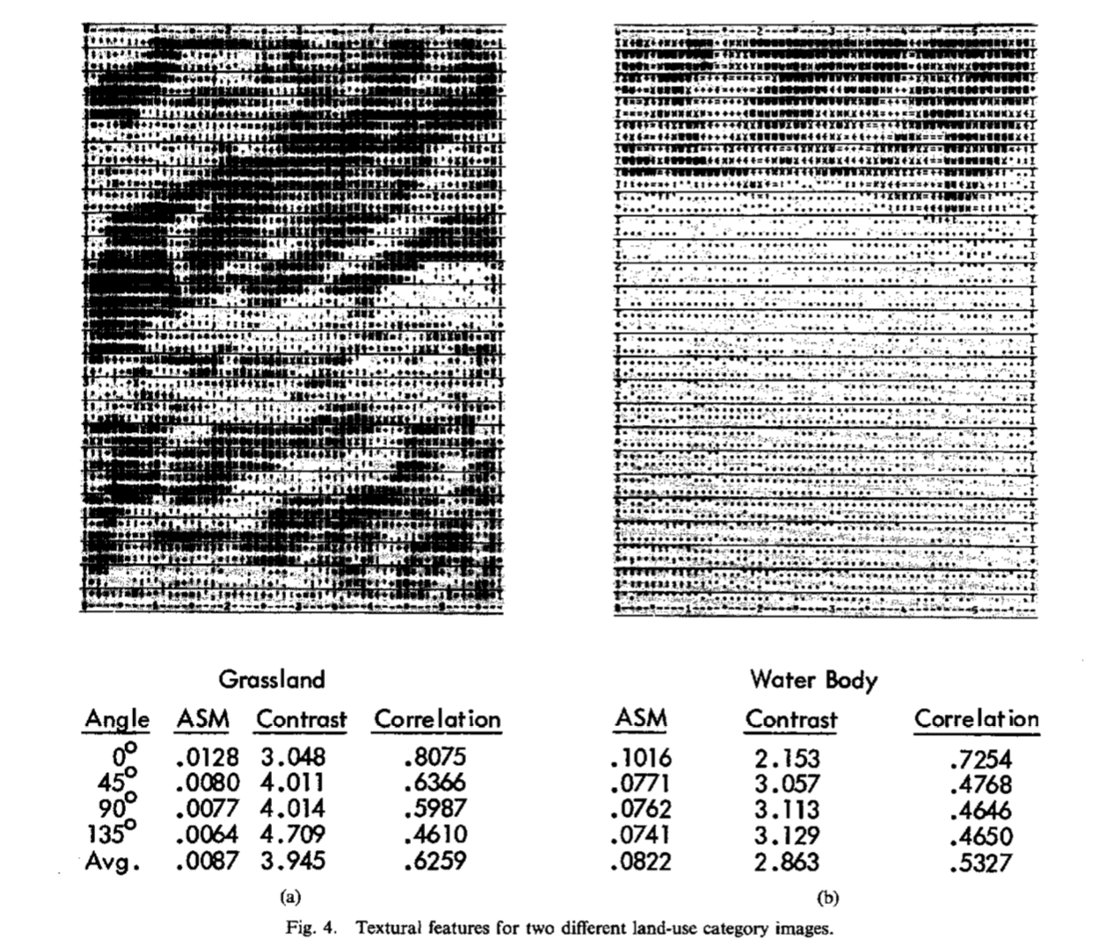
GLCM example

